Slide 1
Link Error Detection and Failure Recovery in Software Defined Networking
Team members Project Guide Dr. V. Mary Anita Rajam
THILLAIRAJA S.T.S.(2012103611)
SUNIL N.K. (2012103602)
SWETHA V.S.(2012103078)

Slide 2
INTRODUCTION
SDN – Software Defined Networking is termed as the “future of networking field”
The entire network is controlled with the help of a single centralized controller which is considered to be the brain of the network.
Easy access of the network is done with the help of this controller since it is controlled with a programmable software.
Typical applications include,
Instruction as a Service (IaaS)
Formation of New IP
Used as geo-distributed campus networks.

Slide 3
OBJECTIVE
To detect link failures in SDN without any delay.
Our objective is to provide a reliable network without any faults.
Detecting and recovery of the link is the prime objective. But maintaining the link is a difficult task.
Storing and compressing the transmitted packets in the switches and provide fast rerouting.
Provide an alternate path using Dijkstra’s algorithm.

Slide 4
LITERATURE SURVEY
S NO | REFERENCE PAPERS | PUBLICATIONS AND YEAR | EXPLANATION
1 | Detour Planning for Fast and Reliable Failure Recovery in SDN with OpenState | Design of Reliable Communication Networks (DRCN), 2015 11th International Conference on 24-27 March 2015 | Provides a secure and a reliable path in case of link failure. Ensures zero packet loss in this mechanism. Routing technique used here is MPLS.
2 | Fast Recovery in Software-Defined Networks | IEEE Software Defined Networks (EWSDN), 2014 Third European Workshop on 1-3 Sept. 2014 | This paper implements a failover scheme with per-link Bidirectional Forwarding Detection sessions and preconfigured primary and secondary paths computed by an OpenFlow controller. Uses two steps- switch-initiated recovery and then controller calculating the optimal paths.
3 | OpenFlow-Based Segment Protection in Ethernet Networks | IEEE/OSA Journal of Vol 5 ,No 1, September 2013 | This paper is based on providing a segment based rerouting algorithm for efficient transfer of messages in case of link failures.
4 | Fault-Tolerant OpenFlow-based Software Switch Architecture with LINC Switches for a Reliable Network Data Exchange | Research and Educational Experiment Workshop (GREE), 2014 Third GENI 19-20 March 2014 | This paper describes the usage of the Erlang Distributed System to replace the hardware switches with open flow software switches to better the fault-tolerance system.

Slide 5
S NO | REFERENCE PAPERS | PUBLICATIONS AND YEAR | EXPLANATION
5 | Orion: A Hybrid Hierarchical Control Plane of Software-Defined Networking for Large-Scale Networks | 2014 IEEE 22nd International Conference on Network Protocols. | This paper explains the Orion architecture which overcomes the issues of the flat control plane structure and the centralized abstracted hierarchical structure of the control plane.
6 | Relaxed Multiple Routing Configurations: IP Fast Reroute for Single and Correlated Failures | IEEE Transactions on network and service management, vol 6, no. 1, MARCH 2009. | The paper puts forth the methodology employed to recover from link failures in a network with the help of Relaxed Multiple Routing Configuration (rMRC).
7 | Scalable Resilience for Software-Defined Networking Using Loop-Free Alternates with Loop Detection | Network Softwarization (NetSoft), 2015 1st IEEE Conference | This paper explains about the usage of Link Free Alternatives(LFAs) to prevent single or multilink failures. Depending upon the three condition in which the LFAs occur, loops might be formed in case of node failure. Hence, a loop detection strategy is used to detect and drop those packets.

Slide 6
PROPOSED SYSTEM
The existing system is based on the process of detecting the link failure in a network and providing a secure path for the packets.
Mostly, the alternate path provided is pre-computed already and is stored in the table.
The existing system uses a working and a transient plane.
Working plane is used till the link failure occurs.
Transient plane comes into play when a link is failed.
The transient plane is like a tree in which the failure node is the root.

Slide 7
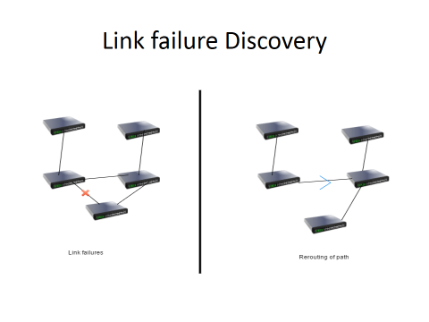

Slide 8
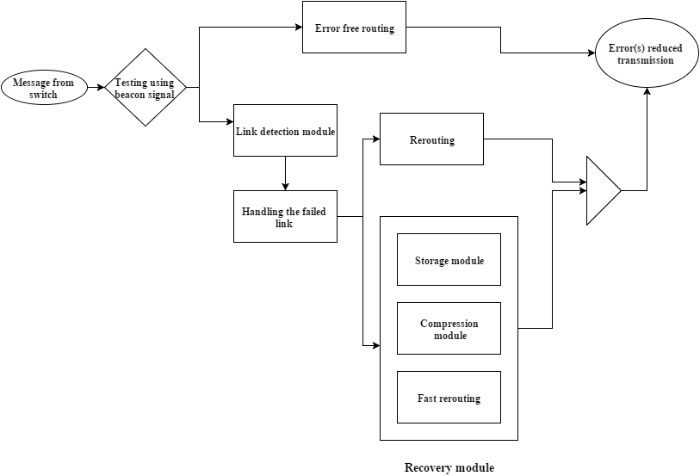
BLOCK DIAGRAM

Slide 9
MODULES SPLIT
Detection Module :
Detection of link failure
Recovery Module :
Storing of dropped packets in compression state.
Handling the failed link using the alternate back path (the packets which are not left from the source).
Stored packets are sent using fast rerouting technique.

Slide 10
Detection Module
Link between nodes is considered to be the framework for any network and so preserving the link is cardinal.
If the network link is error free ,it reroutes and finally transmits the packets without any loss.
If a link failure is detected, the nodes between the failed link is identified.
After the detection of link failure, input is then passed to the recovery module,and the open flow protocol intimates the SDN controller.

Slide 11
Recovery Module
Packets that are not left from the source are rerouted in pre-calculated alternate path.
Packets that are transmitted before the detected failed link are stored in the switch in the compressed state .
The stored packets are then decompressed and fast rerouted to the destined node.
SDN controller controls all the rerouting paths using Dijkstra’s algorithm.

Slide 12
REFERENCES
Nattapong Kitsuwan , Seamos McGettrick , Frank Slyne , David B. Payne , Marco Ruffini , “Independent Transient Plane Design for Protection in openFlow Based Networks”, IEEE/OSA Journal, Vol 7 , March 2015.
Niels L. M. van Adrichem, Benjamin J. van Asten and Fernando A. Kuipers, “Fast Recovery in Software Defined Networks” in IEEE Software Defined Networks (EWSDN), 2014 Third European Workshop on 1­3 Sept. 2014.
Yonghong Fu, Jun Bi, Kai Gao, Ze Chen, Jianping Wu and Bin Hao, “Orion: A Hybrid Hierarchical Control Plane of Software­Defined Networking for Large­Scale Networks” , 2014 IEEE 22nd International Conference on Network Protocols.

Slide 13
(Continued)
Nor Masri Sahri and Koji Okamura, “Openflow Path Fast Failover Fast Convergence Mechanism” , Network Research Workshop Proceedings of the Asia Pacific Advanced Network 2014 v. 38, p. 23­28.
Tarik ˇ Ciˇci´c, Audun Fosselie Hansen, Amund Kvalbein, Matthias Hartmann, R¨udiger Martin, Michael Menth,Stein Gjessing, and Olav Lysne, ”Relaxed Multiple Routing Configurations: IP Fast Reroute for Single and Correlated Failures” , IEEE TRANSACTIONS ON NETWORK AND SERVICE MANAGEMENT, VOL. 6, NO. 1, MARCH 2009.

